Slide 1
PYHTON
LIST

Slide 2

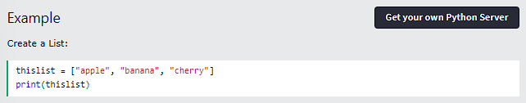
PYTHON LISTS
LIST
Lists are used to store multiple items in a single variable.
Lists are one of 4 built-in data types in Python used to store collections of data, the other 3 are Tuple, Set, and Dictionary, all with different qualities and usage.
Lists are created using square brackets:

Slide 3
PYTHON LISTS
LIST ITEMS
List items are ordered, changeable, and allow duplicate values.
List items are indexed, the first item has index [0], the second item has index [1] etc.
ORDERED
When we say that lists are ordered, it means that the items have a defined order, and that order will not change. If you add new items to a list, the new items will be placed at the end of the list.
CHANGEABLE
The list is changeable, meaning that we can change, add, and remove items in a list after it has been created.

Slide 4
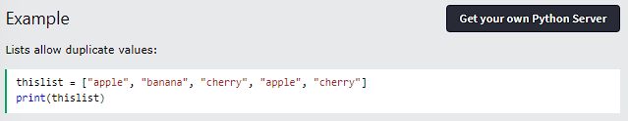
PYTHON LISTS
ALLOW DUPLICATES
Since lists are indexed, lists can have items with the same value:

Slide 5
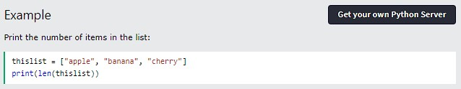
PYTHON LISTS
LIST LENGTH
To determine how many items a list has, use the len() function:

Slide 6
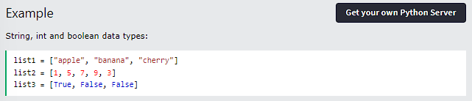
PYTHON LISTS
LIST ITEMS - DATA TYPES
List items can be of any data type:

Slide 7
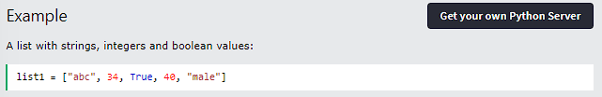
PYTHON LISTS
A list can contain different data types:

Slide 8

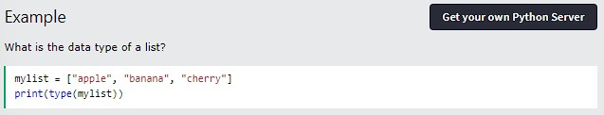
PYTHON LISTS
TYPE()
From Python's perspective, lists are defined as objects with the data type 'list':

Slide 9
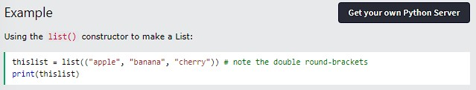
PYTHON LISTS
THE LIST() CONSTRUCTOR
It is also possible to use the list() constructor when creating a new list.

Slide 10

PYTHON LISTS
PYTHON COLLECTIONS (ARRAYS)
There are four collection data types in the Python programming language:
List is a collection which is ordered and changeable. Allows duplicate members.
Tuple is a collection which is ordered and unchangeable. Allows duplicate members.
Set is a collection which is unordered, unchangeable*, and unindexed. No duplicate members.
Dictionary is a collection which is ordered** and changeable. No duplicate members.
When choosing a collection type, it is useful to understand the properties of that type. Choosing the right type for a particular data set could mean retention of meaning, and, it could mean an increase in efficiency or security.

Slide 11
THANK YOU

Slide 12
Python
Access List Items

Slide 13
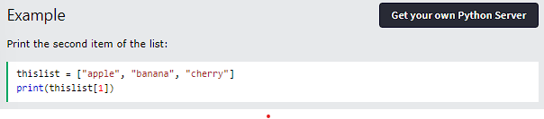

Python - Access List Items
Access Items
List items are indexed and you can access them by referring to the index number:

Slide 14
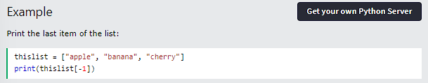
Python - Access List Items
Negative Indexing
Negative indexing means start from the end
-1 refers to the last item, -2 refers to the second last item etc.

Slide 15
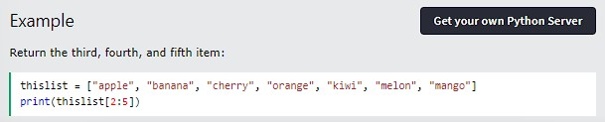
Python - Access List Items
Range of Indexes
You can specify a range of indexes by specifying where to start and where to end the range. When specifying a range, the return value will be a new list with the specified items.

Slide 16
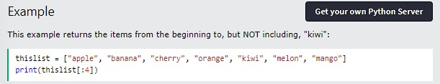
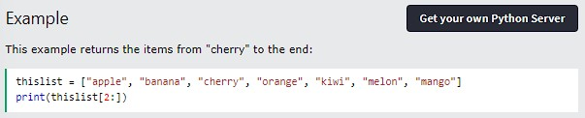
Python - Access List Items
By leaving out the start value, the range will start at the first item:
By leaving out the end value, the range will go on to the end of the list:

Slide 17
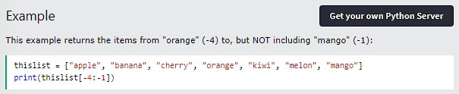
Python - Access List Items
Range of Negative Indexes
Specify negative indexes if you want to start the search from the end of the list:

Slide 18
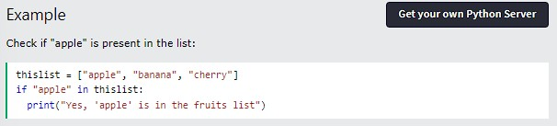
Python - Access List Items
Check if Item Exists
To determine if a specified item is present in a list use the in keyword:

Slide 19
Thank You

Slide 20
PYHTON
CHANGE LIST ITEMS

Slide 21
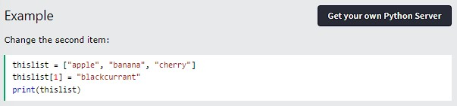
PYTHON CHANGE LIST ITEMS
CHANGE ITEM VALUE
To change the value of a specific item, refer to the index number:

Slide 22
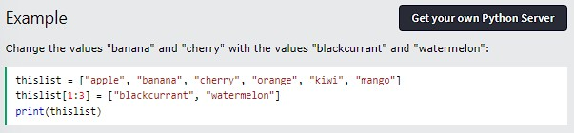
PYTHON CHANGE LIST ITEMS
CHANGE A RANGE OF ITEM VALUES
To change the value of items within a specific range, define a list with the new values, and refer to the range of index numbers where you want to insert the new values:

Slide 23
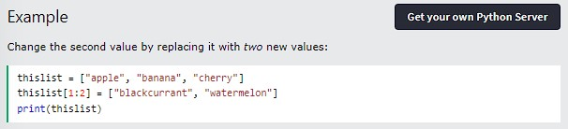
PYTHON CHANGE LIST ITEMS
If you insert more items than you replace, the new items will be inserted where you specified, and the remaining items will move accordingly:

Slide 24
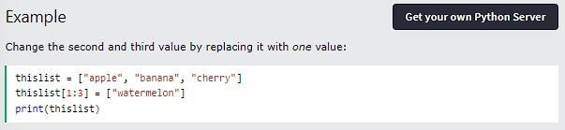
PYTHON CHANGE LIST ITEMS
If you insert less items than you replace, the new items will be inserted where you specified, and the remaining items will move accordingly:

Slide 25
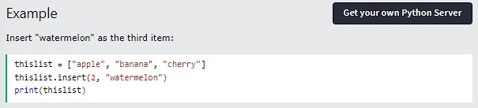
PYTHON CHANGE LIST ITEMS
INSERT ITEMS
To insert a new list item, without replacing any of the existing values, we can use the insert() method. The insert() method inserts an item at the specified index:

Slide 26
THANK YOU

Slide 27
Python
Add List Items

Slide 28
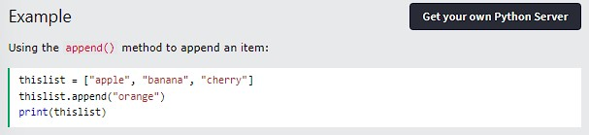
Python - Add List Items
Append Items
To add an item to the end of the list, use the append() method:

Slide 29
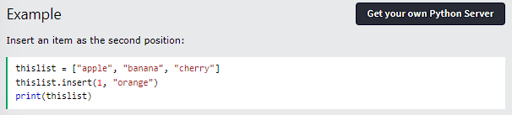
Python - Add List Items
Insert Items
To insert a list item at a specified index, use the insert() method. The insert() method inserts an item at the specified index:

Slide 30
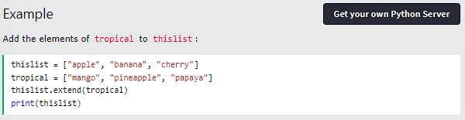
Python - Add List Items
Extend List
To append elements from another list to the current list, use the extend() method.
The elements will be added to the end of the list.

Slide 31
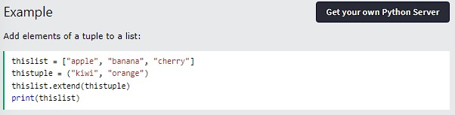
Python - Add List Items
Add Any Iterable
The extend() method does not have to append lists, you can add any iterable object (tuples, sets, dictionaries etc.).

Slide 32
Thank You

Slide 33
PYHTON
REMOVE LIST ITEMS

Slide 34
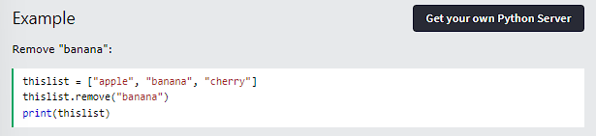
PYTHON REMOVE LIST ITEMS
REMOVE SPECIFIED ITEM
The remove() method removes the specified item.

Slide 35
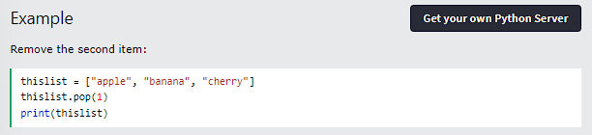
PYTHON REMOVE LIST ITEMS
REMOVE SPECIFIED INDEX
The pop() method removes the specified index.

Slide 36
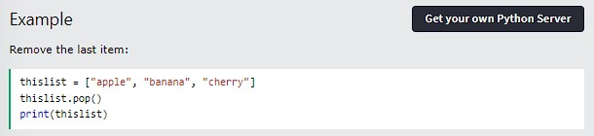
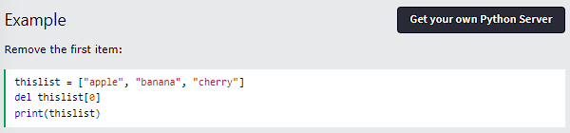
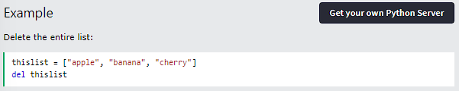
PYTHON REMOVE LIST ITEMS
If you do not specify the index, the pop() method removes The del keyword also removes the specified index: the last item.
The del keyword can also delete the list completely.

Slide 37
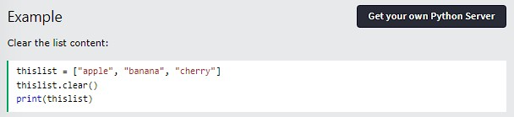
PYTHON REMOVE LIST ITEMS
CLEAR THE LIST
he clear() method empties the list.
The list still remains, but it has no content.

Slide 38
THANK YOU

Slide 39
Python Loop Lists

Slide 40
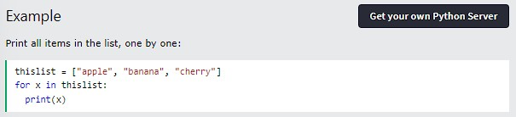
Python - Loop List
Loop Through a List
You can loop through the list items by using a for loop:
Learn more about for loops in our Python For Loops Chapter.

Slide 41
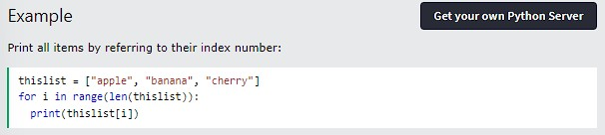
Python - Loop List
Loop Through the Index Numbers
You can also loop through the list items by referring to their index number. Use the range() and len() functions to create a suitable iterable.
The iterable created in the example above is [0, 1, 2].

Slide 42
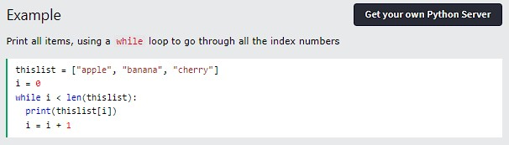
Python - Loop List
Using a While Loop
You can loop through the list items by using a while loop.
Use the len() function to determine the length of the list, then start at 0 and loop your way through the list items by referring to their indexes.
Remember to increase the index by 1 after each iteration.
Learn more about while loops in our Python While Loops Chapter.

Slide 43
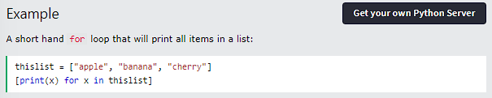
Python - Loop List
Looping Using List Comprehension
List Comprehension offers the shortest syntax for looping through lists:

Slide 44
Thank You

Slide 45
PYHTON
LIST COMPREHENSION

Slide 46
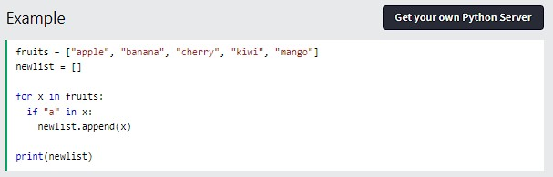
PYTHON - LIST COMPREHENSION
LIST COMPREHENSION
List comprehension offers a shorter syntax when you want to create a new list based on the values of an existing list. Example:
Based on a list of fruits, you want a new list, containing only the fruits with the letter "a" in the name. Without list comprehension you will have to write a for statement with a conditional test inside:

Slide 47
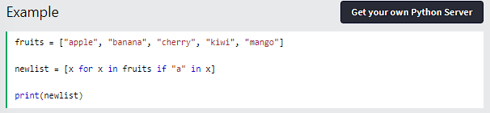
PYTHON - LIST COMPREHENSION
With list comprehension you can do all that with only one line of code:
THE SYNTAX
The return value is a new list, leaving the old list unchanged.

Slide 48
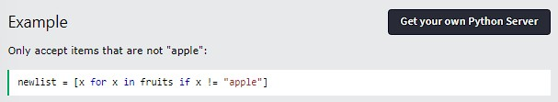
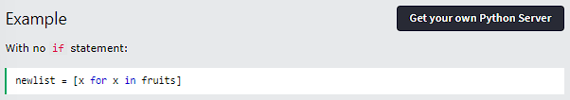
PYTHON - LIST COMPREHENSION
CONDITION
The condition is like a filter that only accepts the items that valuate to True.
The condition if x != "apple" will return True for all elements other than "apple", making the new list contain all fruits except "apple". The condition is optional and can be omitted:

Slide 49
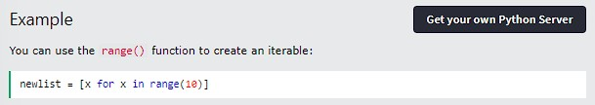
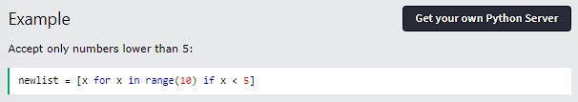
PYTHON - LIST COMPREHENSION
ITERABLE
The iterable can be any iterable object, like a list, tuple, set etc.
Same example, but with a condition:

Slide 50
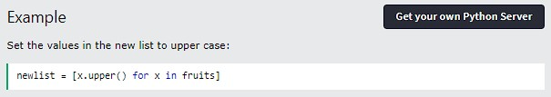
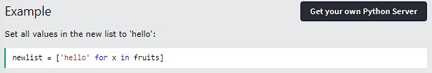
PYTHON - LIST COMPREHENSION
EXPRESSION
The expression is the current item in the iteration, but it is also the outcome, which you can manipulate before it ends up like a list item in the new list:
You can set the outcome to whatever you like:

Slide 51
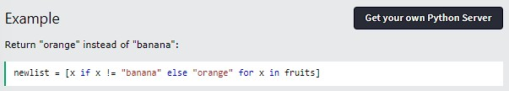
PYTHON - LIST COMPREHENSION
The expression can also contain conditions, not like a filter, but as a way to manipulate the outcome:
The expression in the example above says:
"Return the item if it is not banana, if it is banana return orange".

Slide 52
THANK YOU

Slide 53
Python Sort Lists

Slide 54
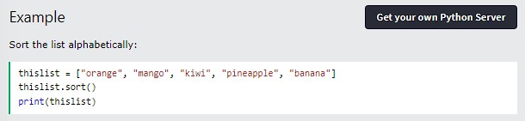
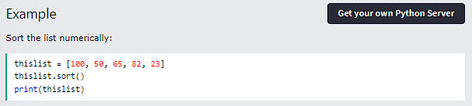
Python - Sort List
Sort List Alphanumerically
List objects have a sort() method that will sort the list alphanumerically, ascending, by default:

Slide 55
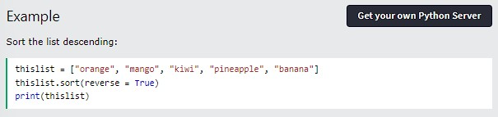
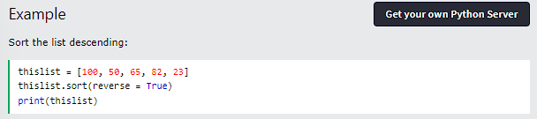
Python - Sort List
Sort Descending
To sort descending, use the keyword argument reverse = True:

Slide 56
Python - Sort List
Sort List Alphanumerically
List objects have a sort() method that will sort the list alphanumerically, ascending, by default:

Slide 57
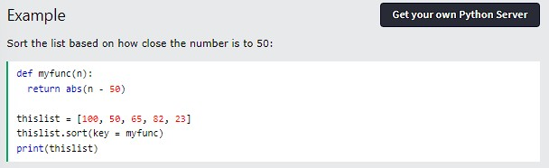
Python - Sort List
Customize Sort Function
You can also customize your own function by using the keyword argument key = function. The function will return a number that will be used to sort the list (the lowest number first):

Slide 58
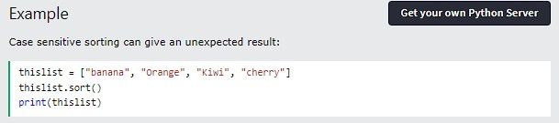
Python - Sort List
Case Insensitive Sort
By default the sort() method is case sensitive, resulting in all capital letters being sorted before lower case letters:

Slide 59
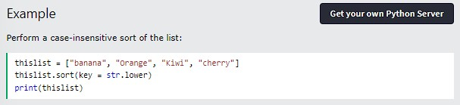
Python - Sort List
Luckily we can use built-in functions as key functions when sorting a list.
So if you want a case-insensitive sort function, use str.lower as a key function:

Slide 60
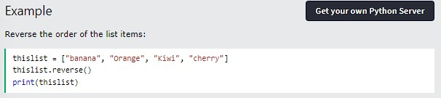
Python - Sort List
Reverse Order
What if you want to reverse the order of a list, regardless of the alphabet? The reverse() method reverses the current sorting order of the elements.

Slide 61
Thank You

Slide 62
Python Sort Lists

Slide 63

Python - Join List
Join Two Lists
There are several ways to join, or concatenate, two or more lists in Python. One of the easiest ways are by using the + operator.

Slide 64


Python - Join List
Another way to join two lists is by appending all the items from list2 into list1, one by one:
Or you can use the extend() method, which purpose is to add elements from one list to another list:

Slide 65
Thank You

Slide 66
PYHTON
COPY LISTS

Slide 67
PYHTON
COPY LISTS

Slide 68


PYTHON - LISTS METHOD
LIST METHODS
Python has a set of built-in methods that you can use on lists.

Slide 69
THANK YOU

Slide 70

PYTHON - COPY LISTS
COPY A LIST
You cannot copy a list simply by typing list2 = list1, because: list2 will only be a reference to list1, and changes made in list1 will automatically also be made in list2.
There are ways to make a copy, one way is to use the built-in List method copy().

Slide 71

PYTHON - COPY LISTS
Another way to make a copy is to use the built-in method list().

Slide 72
THANK YOU

Slide 73
Python
List Exercises

Slide 74

Python - List Exercises
Test Yourself With Exercises
Now you have learned a lot about lists, and how to use them in Python. Are you ready for a test?
Try to insert the missing part to make the code work as expected:

Slide 75
Thank You

